Slide 1
TokenSpy
YOUR LOGO
A tool for real-time monitoring of cryptocurrency address token transfer activities.

Slide 2
Project Overview
PART 01

Slide 3
TokenSpy
TokenSpy is a blockchain-based data activity monitoring tool.
01
02
Unique Value Proposition: TokenSpy helps users capture market opportunities and avoid missing important market dynamics by providing real-time and accurate token inflow monitoring services.
04
Slogan: Master the Market Pulse, Insight into Fund Movements at a Glance
05
Provide a platform for real-time tracking and analyzing whale wallet activities, enabling users to gain insights into large transactions and fund flows to predict market trends.。
03
TokenSpy offer a one-stop solution for users' needs from searching to trading, providing real-time monitoring of cryptocurrency address token movements to help users gain insights into market dynamics.

Slide 4
Current Market Situation
PART 02

Slide 5
Current Market Situation
Status Quo: Existing tools like Jupiter offer only swapping services, while Birdeye lacks user-friendliness, and many tools do not support the Solana blockchain.
Need: There's a gap in the market for an integrated service platform that provides comprehensive on-chain data analysis, especially for the Solana ecosystem.

Slide 6
Market Demand Analysis
Investors' Pursuit of Transparency
Growing Demand for Blockchain Technology
With the widespread adoption of blockchain technology, the market demand for projects like TokenSpy is gradually increasing.
TokenSpy offers real-time, transparent blockchain data analysis to meet investors' demand for information transparency.
Market Competition Analysis
Regulatory Compliance Requirements
TokenSpy assists project owners and investors in meeting regulatory requirements to ensure compliant operations.
TokenSpy faces fierce competition in the market from products such as BirdEye and dexScreener, requiring continuous enhancement of product features and user experience.

Slide 7
Product Features
PART 03

Slide 8

Address Monitoring and Real-time Notifications
01
Real-time Monitoring
TokenSpy is capable of monitoring the transaction status of target addresses in real-time, ensuring that users stay informed of developments promptly.
02
Accurate Positioning
Through advanced address analysis technology, TokenSpy accurately identifies and displays address transaction details.
03
Real-time Notifications
Once abnormal transactions or conditions meeting preset criteria are detected, the system immediately notifies the user.
04
Multiple Notification Methods
Supporting multiple notification methods such as SMS, email, and app push notifications ensures that users do not miss any important information.
05
Customizable Monitoring Rules
Users can set personalized monitoring rules according to their own needs, improving monitoring efficiency.
06
Data Security
TokenSpy employs advanced encryption technology to ensure the security and reliability of user data and transaction information.

Slide 9
AI Analysis of Smart Money Trading Trends
Using deep learning and natural language processing technologies, AI can accurately identify and analyze the trading behavior of smart money.
By monitoring a large volume of transaction data, AI can discover the trading trends of smart money, providing valuable insights for investors.
AI analysis of smart money trading trends helps investors grasp market trends and improve the accuracy of investment decisions.
It also helps investors avoid blindly following trends, reducing investment risks.
Investors can gain a better understanding of the market and improve investment returns.
01
02
03
04
05

Slide 10
Product UI Showcase
PART 04

Slide 11
Demo插入与操作流程演示
01
Demo插入
展示Demo视频，呈现产品界面和功能
02
操作流程演示
详细演示产品操作流程，包括登录、注册、使用等步骤
03
界面特点解析
分析产品界面设计特点，如色彩搭配、布局规划等
04
功能亮点展示
突出产品核心功能，如数据分析、实时监控等，并解释其优势和应用场景
05
操作体验优化建议
根据演示过程中的用户反馈，提出优化建议和改进方向

Slide 12
Tokenomics and Incentive Mechanism
PART 05

Slide 13
激励机制与Arkham模式
Incentive Mechanism: Users holding TokenSpy tokens can stake them to post questions, with respondents receiving rewards, similar to the Arkham model.
Users can earn token rewards by completing specific tasks or providing valuable services, thereby incentivizing their active participation in the project.
Token allocation and reward mechanisms are flexibly designed according to the needs and goals of the project, and can include various methods such as regular distribution, task completion rewards, and community voting.
By leveraging the scarcity of tokens and their potential for value appreciation, we can further stimulate user engagement, thereby promoting the long-term development and prosperity of the project.

Slide 14
Utilizing Solana's Features
PART 06

Slide 15

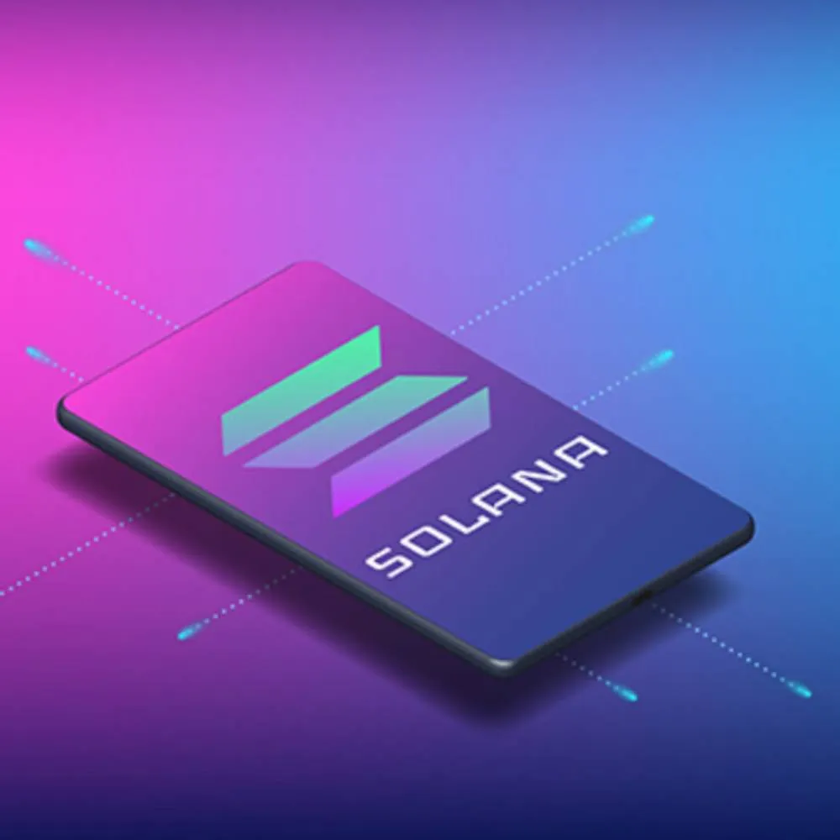
Fast transaction speed and the ability to handle large volumes of data
Fast transaction
Handling large data
Solana adopts a consensus mechanism called "Proof of History," which enables transaction speeds of thousands of transactions per second, significantly lower latency compared to other blockchains.
Solana supports large-scale data storage and computation, providing a plethora of interfaces for easy integration and service expansion, which offers powerful data processing capabilities for the TokenSpy project.
Low cost
High security
Due to Solana adopts a decentralized architecture, which reduces intermediary costs during the transaction process, the TokenSpy project experiences significantly reduced operating costs, thereby enhancing its profitability.
Solana employs multiple security measures such as multi-signature authentication and encrypted communication to ensure the security and privacy of transaction data, providing reliable security protection for the TokenSpy project.

Slide 16
GitHub interface
PART 07

Slide 17
GitHub界面展示与项目透明度
01
GitHub界面
清晰展示TokenSpy项目的代码库、提交记录、分支等信息。
02
开源声明
强调项目开源，鼓励社区参与，提高项目透明度。
03
许可证
明确项目使用的许可证类型，保障代码使用的合法性和规范性。
04
贡献者列表
展示项目贡献者名单，感谢他们的付出，同时吸引更多开发者加入。
05
文档和教程
提供详细的文档和教程，方便用户理解和使用项目。
06
实时更新
定期更新项目状态，保持与社区的及时沟通，提高项目的活跃度和可信度。

Slide 18
Future Vision
PART 08

Slide 19
Development Directions
01
Integration with Telegram Bot/Web App for more convenient service channels
02
Development of a proprietary wallet with integrated data analysis functions
03
Exploring socialization and trade bots to expand service scope and user base

Slide 20
Thanks！
YOUR LOGO

